Slide 1
Five Steps to Better Gifted Student Identification
Scott J. Peters, Ph.D.

Slide 2
The Five!
ID system – Program Alignment
Universal Screening
Lower Cut Scores / Criteria
Local Norms
Group-Specific Norms

Slide 3
Identification
What makes it good?
What are the characteristics of a “good” identification system?

Slide 4
Identification
High sensitivity rate: “finds” all of the kids it’s supposed to find
Follows the “lazy” teacher philosophy: do no more testing and assessment than necessary
Is proactive with regard to underrepresentation

Slide 5
#1 Alignment
If your identification process measures skills A, B, and C….but your program is related to talent development in D, 9, &, and f
Poor sensitivity, more testing than necessary, etc.
Nothing else you do to improve your ID system will matter

Slide 6
Example
For which of the following programs is it easiest to create an identification system?
Baccalaureate college
Graduate school
Medical school
Gifted education
And why?

Slide 7
Alignment Example
You ID students based on high math scores, high reading scores, or high teacher ratings and then provide them with a creative problem solving curriculum
You ID students based on language arts / reading WKCE scores and then allow them to participate in Lego League

Slide 8
Alignment Example
You ID students using an IQ test and those who score 130+ receive math enrichment
You ID students using a nonverbal ability test (e.g., NNAT, TONI) and then provide those who score 130+ with advanced math, reading, and science
Dina’s example from yesterday

Slide 9
Fixing Alignment
The skills and abilities measured in your ID process must be related to success in the program to be provided
Think about all of the skills and abilities necessary to be successful in and benefit from the program that will be provided to those identified.

Slide 10
#2 Universal Screening
Let’s assume you’ve fixed the alignment…
However you ID students, it’s always best to put ALL students through that process.
Always, always, always!
Results in the fewest students missed
Notes:
Explain what it means for a student to be missed.
Also important to use high-quality tests = those with high reliability

Slide 11
Universal Screening
% of overall student population screened for GT
~16%
% of GT students missed / not ID’d

Slide 12
Universal Screening
Does anyone’s school do something other than universal screening at a given grade level?
Example

Slide 13
The two-stage ID model
Nomination
Confirmation Test
Teacher Nomination
CogAT
Gifted Land!

Slide 14
This two-phase system can only decrease performance relative to everyone taking the confirmatory test
Take home message: non-universal testing for giftedness is always worse than universal screening in terms of efficacy
Decreased cost, inconvenience, and risk justify tradeoff – if performance detriment is minimal

Slide 15
Answers
Universally screen if you can
If you can’t….
Screen as large a % of kids as you can get away with
Lower the threshold of the first phase / nomination
Make sure the skills measured by the first and second phase instruments are as strongly related as possible
Notes:
Instead of screening everyone, screen everyone who was at least at grade level last year. Or those who are rated by their teacher as being in the top half of the class.

Slide 16
Answers
Stage One instrument: SIGS
Stage Two instrument: CogAT
Nomination cutoff: top 10% on the general intellectual ability subscale (90th percentile)
Nomination validity: 0.48
Test cutoff: 90th percentile
Test reliability: 0.95
Result: We miss 78% of the GT kids
this is 34% of the optimal (single stage) value
Notes:
Here’s the scenario: a school doesn’t want to have to spend the money or take the time to give the CogAT to its entire student population. Instead, it’s going to have all teachers rate the entire population using the SIGS. Then, those students who receive a SIGS score >90th percentile will be given the CogAT as a confirmation assessment.

Slide 17
Example
Broward County Schools (Florida)

Slide 18
#3 Lower Cut Scores
The kinds of cut scores used in GT ID (e.g., top 1%, 2%, 3%) are all but indefensible
Conditional standard error*
Program benefits
Exacerbate underrepresentation

Slide 19
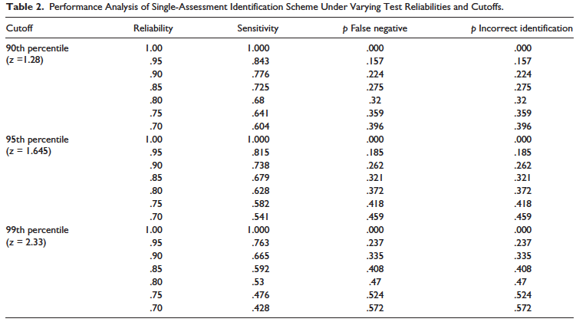
McBee, Peters, Waterman

Slide 20
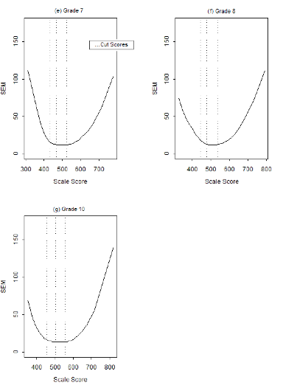
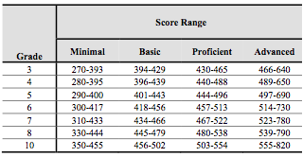
Error curves for WKCE Reading

Slide 21
Standard Errors
*This applies to any non-adaptive, fixed form tests (e.g., WKCE, ACT, OLSAT)
Less accurate / precise at the extremes – such as the 98th percentiles
Makes decisions less accurate
Exacerbate false negatives – will cause us to miss more kids who are actually at this level

Slide 22
Program Benefits
Can we say with confidence that only students at the 98th percentile or above will benefit from the intervention and that those at the 97th percentile will not?

Slide 23
Program Benefits
Card and Giuliano (2014) used data from Ft. Lauderdale Schools
Students identified via IQ scores (130+) showed no benefit from the GT program
Students identified with above-average achievement showed significant benefit
Cut scores need to be criterion based

Slide 24
Underrepresentation
Although lowering cut scores won’t solve underrepresentation (ever), on average, the higher they are, the worse underrepresentation will be.
But lowering them will also identify more students of all student subgroups…

Slide 25
#4 Local Norms
Unless your “program” or intervention will serve a national audience, there is no reason to use national norms for GT ID.
Instead of ID’ing those who score 98th percentile on a national norm, ID those who score at the 98th percentile within your school
Dave Lohman local norm spreadsheet

Slide 26
#4 Local Norms
Local norms will make the size of your GT population more predictable
They will even out the % of GT students in each building and in each school district
In some cases they will help with underrepresentation
They are philosophically defensible

Slide 27
#5 Group Specific Norms
Serves only to increase the number of underrepresented students identified as GT
Involves comparing students of a certain student subgroup only to those of that same subgroup
ELL to other ELL
Low-income only to other low-income students

Slide 28
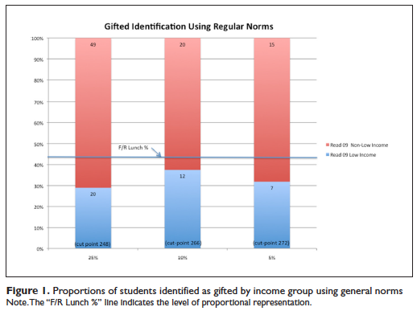
#5 Group Specific Norms
Using local norms for everyone

Slide 29
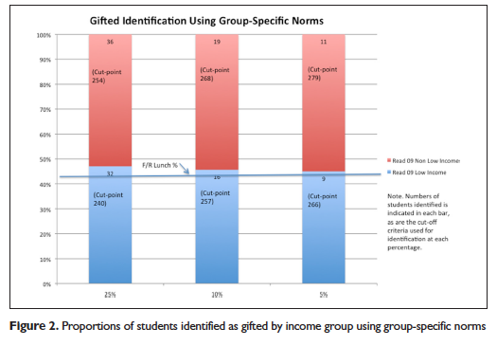
#5 Group Specific Norms
Using local norms for everyone plus a group-specific comparison for low-income students

Slide 30
#5 Group Specific Norms
Cautions:
Really only appropriate for ELL or low-income
Political challenges
Readiness challenges – these students will need alternative interventions or greater support to be successful.

Slide 31
Answers
Make sure your ID process is actually related to the intervention to be provided.
If there is no intervention, don’t ID
Universally screen or get as close to it as possible (screen the largest % of kids as you can get away with)

Slide 32
Answers
3. Lower the cut score: 97+ is almost never defensible unless you’re using a CAT, out-of-level test, or individually-administered test
4. Use local norms whenever you’re making a norm-referenced ID decision
5. Consider group-specific norms to address underrepresentation

Slide 33
Google Folder
See Google Folder for resources:
http://tinyurl.com/jh9vddl

