Slide 1
Making InRoads for Gifted Learners
NAGC 2014 Convention Baltimore, Maryland

Slide 2
Just in Time PD Booster shots
8 PD sessions: 30-45 Minutes long
Powerpoint with audio files
Script
Facilitator’s Guide
Resources and activities
http://ncaig.ncdpi.wikispaces.net/

Slide 3
Common Core and Gifted - Panel
5 Myths:
We don’t need gifted anymore - CC is the floor not the ceiling
CCSS are “ready to go” - not developed beyond algebra II
CCSS are adaptive - not really, grade level designed, but better than non adaptive tests

Slide 4
Common Core and Gifted
Differentiation will address concerns - not required so intermittent
Increase rigor is bound to work for gifted students - even with more rigorous standards gifted students don’t thrive.
Fordham Institute : Can Gifted Survive the CCSS

Slide 5
Common Core and Gifted
Recommendations:
Demand/require gifted best practices and resources
Interdisciplinary connections - Project Based
Mandate training for gifted teachers
Use research models that work
DEPs for individual students

Slide 6
Putting Research Into Practice
Avoid readicide and killing off joy by over/under teaching books, test takers vs readers, and limiting authentic reading experiences
Use technology and QR codes for book trailers
Read Write Think, SEM-R, Nearpod, and Adlit.org Website

Slide 7
Program Evaluation Skill & Will
Effective if :
District internally requests, ask the right specific questions, ID stakeholders and include them in the process, skilled evaluator, funding secured to make the recommended changes
Ineffective if :
Externally imposed, questions too general, all stakeholders not included, district not willing to change
cmc@virginia.edu

Slide 8
Multicultural and Rigorous - Ford
Focus on topics and issues in literature
Examine school policy, create one
Culturally sensitive questions
Unpack misconceptions, develop empathy
Districts that lack diversity need this the most
Use Bloom-Banks Matrix to improve lesson

Slide 9
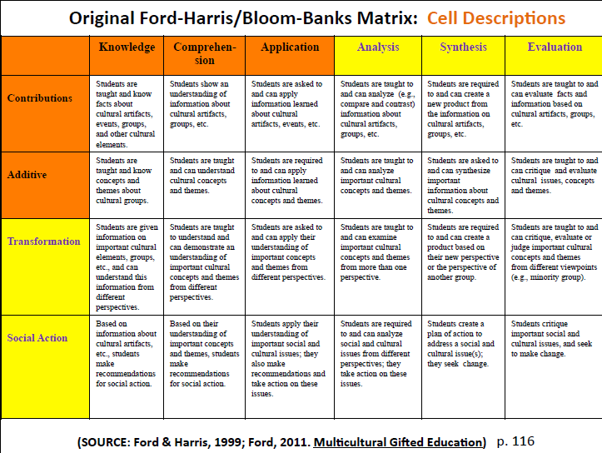
Bloom-Banks Matrix

Slide 10
Capacity Building Coaching
Coaching Heavy or Coaching Light?
http://www.pps.k12.or.us/files/teaching-and-learning/Coaching_Heavy_Light_.pdf
Jim Knight - video clips on coaching
Multi tiered initiative includes gap analysis, teams of coaches, time to coach, building coach capacity, collaboration with coaches

Slide 11
Cultural Sensitivity in GT
Representation matters! What is on your walls, what holidays get recognized/celebrated, are your staff members “color” blind? Panel member: “SEE ME!”
What stories (whose stories) get told in the books your Ss are being asked to read? LGBTQ, Black, Hispanic, Native American, White?
How do you offer the challenge necessary without offering materials that are too mature?
Do students grasp the concept of privilege?
Working around socio-economic protections - ensuring identification

Slide 12
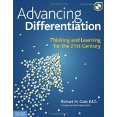
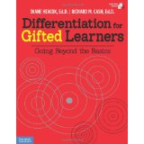
Richard Cash
Instructional Practices for Secondary Gifted Students: http://nrichconsulting.com.s130784.gridserver.com/wp-content/uploads/2014/11/Secondary-GT-Workshop.pdf
New resource written with
Diane Heacox

Slide 13
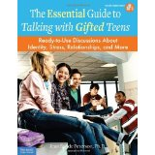
Richard Cash
Social/Emotional Development
of Gifted Adolescents
Today’s neo-millennials:
24/7 random learners
http://nrichconsulting.com.s130784.gridserver.com/wp-content/uploads/2014/11/Balancing-Act-HandoutR.pdf

Slide 14
Perfectionism and Its Antidotes
Thomas S. Greenspon
A Self-Esteem Issue: Mistakes = personal failure
Anxiety about Failure
Appears in different “flavors”
http://www.eventscribe.com/2014/nagc/assets/handouts/120420.pdf

Slide 15
Antidotes
Create an environment of acceptance
Talk about it!
Understand the anxiety surrounding mistakes
Praise effort & persistence not performance
Like others for who they are--not what they can achieve.

Slide 16
Critical Reflection in Writing
April Keck DeGennaro
K-5 Resource; Fayetteville, GA
Students write reflections; parents read and discuss; Teacher reads and comments
Inspriational video to start: https://www.youtube.com/watch?v=CK5cLLCIpxQ
Handout:
https://docs.google.com/presentation/d/1vCHn1n3m9Z6zIVTXO9jiJNSFC4qStIBdhwKOoOLMHlM/edit#slide=id.p17

Slide 17
Spiritually Gifted
“...to have experience with what is not seen.” W. James Profound sensitivity and compassion
Gentle nature
Depth of empathy
Integrity
Honesty
Intuitive inner guidance
Watch for the book by: Patricia Gatto-Walden

Slide 18
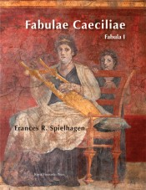
Greek and Latin Roots
Dr. VanTassel-Baska
from William & Mary
Integrated curriculum model--
connections across time
Royal Fireworks Press
www.rfwp.com

