Slide 1
Advanced Learning in the Arts
Laurie Fellenz, Arts Education Coordinator
Thursday, March 10, 2016

Slide 2
PURPOSE
Share information about MMSD Arts Education and Any Given Child Madison
Understand identification of Advanced Learners in MMSD (Advanced Learner Plan) and Tier 2/3 options
Dialogue about identification and interventions

Slide 3
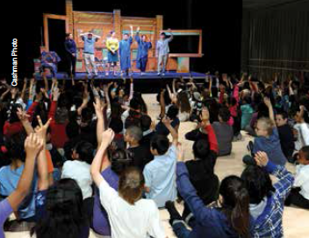
Think about the best arts education experience you ever had…
What is one word you would use to describe that experience?
What is one word you would use to describe the impact of that experience on you?
Notes:
Intentionally frame the conversation about role/expectations in the arts through the lens of students experiencing a rich, joyful arts education.

Slide 4
CURRICULUM AND INSTRUCTION DEPARTMENT

Slide 5
Priority Area 1: Coherent Instruction
Provide every student with well-rounded, culturally responsive and coherent instruction that leads to college, career and community readiness.
Notes:
Laurie - Before we move into the information to advanced learning, it is important to ground today’s work in the Strategic Framework and the Great Teaching Matters Framework. The role we play as art and music educators and advanced learning instructional resource teachers are directly connected to Priority Area #1 of the MMSD Strategic Framework around Coherent Instruction. We are charged with providing every student with well-rounded, culturally responsive, and coherent instruction that leads to college, career, and community readiness. Every student needs to access instruction that meets them where they are and supports their growth to the next level. For students who have advanced learning needs, we will use differentiated instructional strategies within our core arts courses to meet a majority of those needs, but there may be times when a students needs are beyond what can be provided during core instruction. We will look at both the differentiated strategy options and Tier 2 and 3 supports in the arts.

Slide 6
Great Teaching Matters Framework
Notes:
Share the Shared Endeavor model of arts education with STUDENTS at the center…

Slide 7
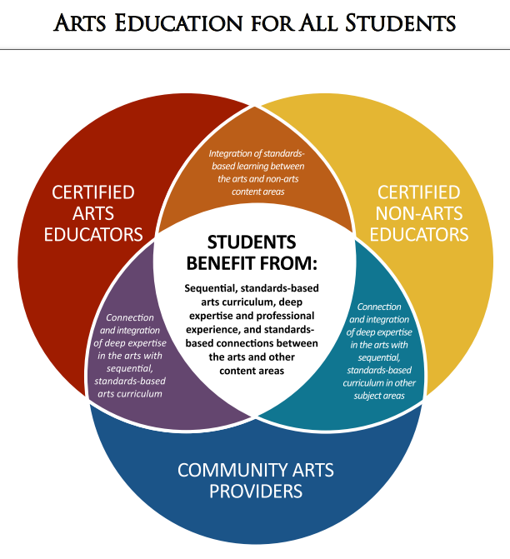
Notes:
Share the Shared Endeavor model of arts education with STUDENTS at the center…

Slide 8
www.anygivenchildmadison.org

Slide 9
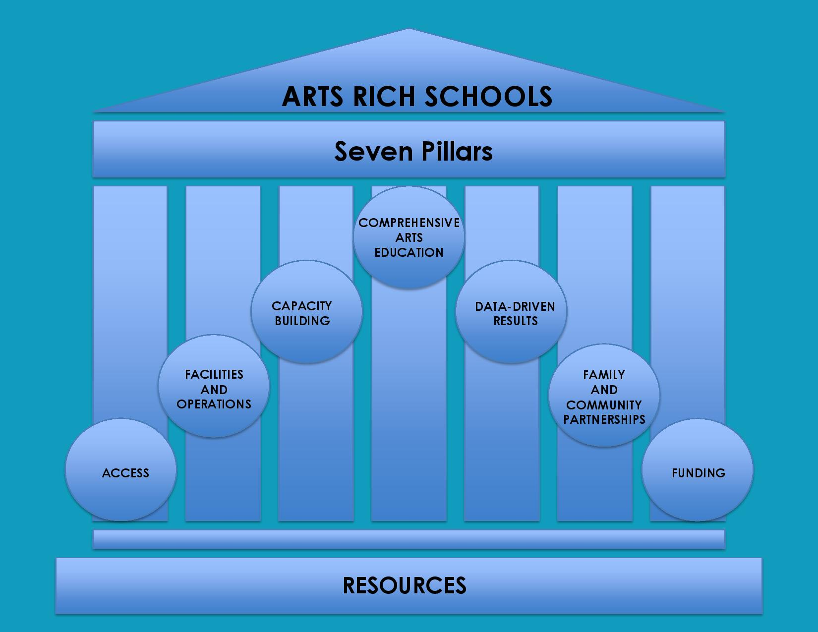

Slide 10
K-8 Equitable Arts Access
Three rotations for elementary schools: Theater Experience, Dance Experience, and Open Experience
MMSD elementary schools receive $500.00 for each experience over a three-year period
Each MMSD middle school receive $500.00 each year for an open experience
Funding from Arts Education budget (as recommended by Board of Education – Arts Task Force)

Slide 11
Community Arts Organizations

Slide 13
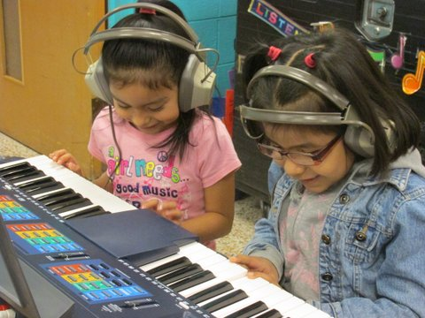
TURN AND TALK
Based on our time together so far…
What have you heard about that intrigues you?
What have you heard that you have more questions about?
Notes:
Meeting facilitator would pause after the first prompt to let people think. Then, they would invite people to share out their one word, either by going around the room or letting people shout them out. The notetaker for the meeting would record these words.
The purpose of this exercise is to 1) get people engaged right away in the process, both in the right frame of mind and just participation in general; and 2) to generate data that would give us some ideas on why good arts education experiences matter (data that Ray and others pointed out would be useful to have).

Slide 14
WHO IS AN ADVANCED LEARNER?
A student who
demonstrates high performance capability
or the potential for high performance
in one or more of the following domains:
General Intellectual, Specific Academic, Visual and Performing Arts, Leadership, and Creativity.

Slide 15
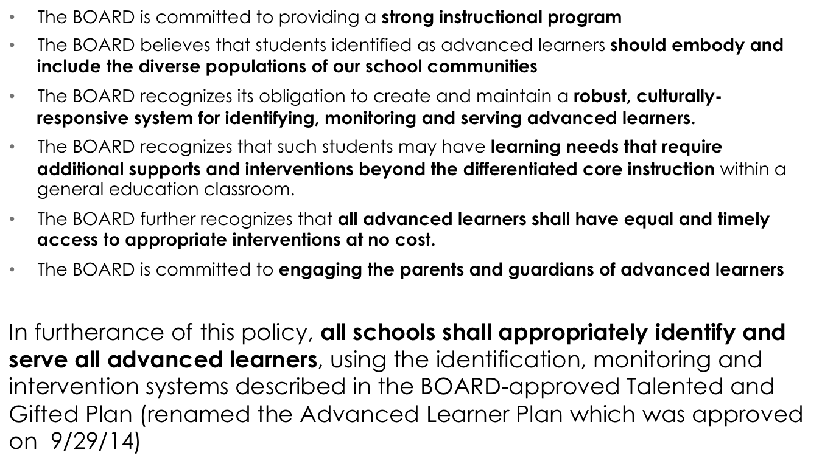
Talented and Gifted
Board of Ed Policy 3555

Slide 16
Identification for Advanced Learner
At least three evidence sources considered and at least two showing consistencies
Identification for Advanced Learner needing Advanced Intervention
At least three evidence sources considered and at least three showing consistencies

Slide 17
VISUAL ARTS
Students will be identified using multiple and varied measures, including the following:
Teacher’s Observation of Potential in Students (TOPS) – U-STARS
Gifted and Talented Evaluation Scales (GATES)
Visual Arts Student Work Review
Teacher Rating Scale
Letter(s) of recommendation from parent, community members, teachers, and/or extra/co-curricular advisors
List of honors/extra curricular involvement

Slide 18
MUSIC
Students will be identified using multiple and varied measures, including the following:
Teacher’s Observation of Potential in Students (TOPS) – U-STARS
Gifted and Talented Evaluation Scales (GATES)
Music Evidence/Student Review
Teacher Rating Scale
Letter(s) of recommendation from parent, community members, teachers, and/or extra/co-curricular advisors
List of honors/extra curricular involvement

Slide 19
STUDENT SUPPORT INTERVENTION TEAM
Since the areas of visual arts and music do not utilize standardized assessment data with quantitative data like general intellectual or content specific identification, a school support team with the addition of a certified arts educator and Advanced Learning staff member will meet to consider the body of evidence (criteria).

Slide 20
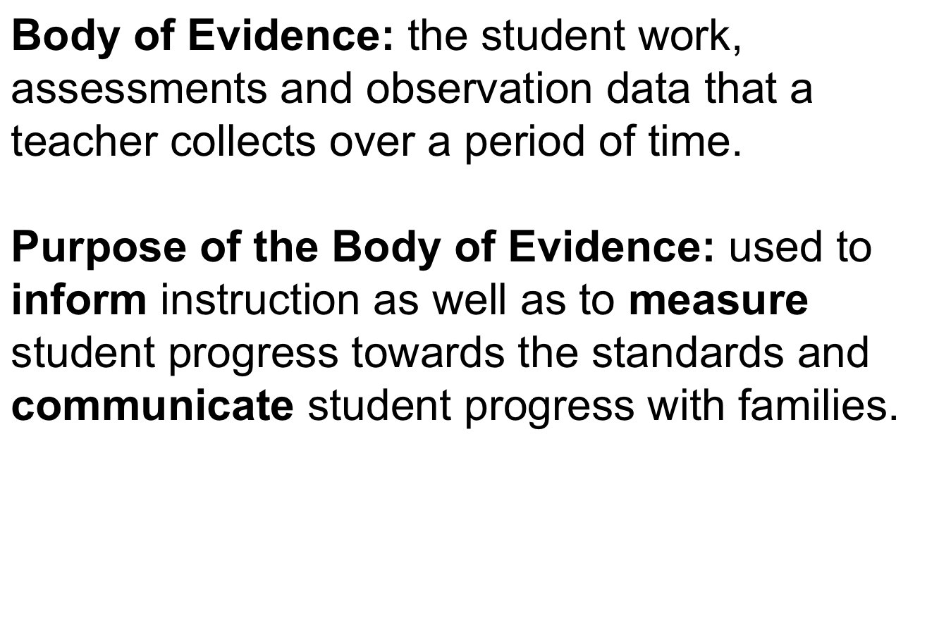
What is a Body of Evidence?

Slide 22
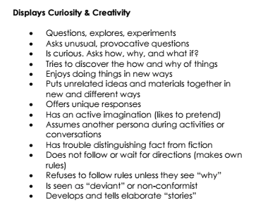

Slide 23
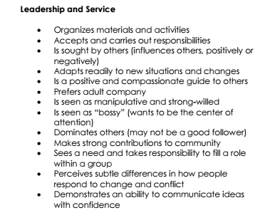

Slide 24
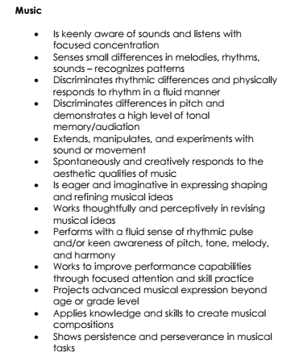

Slide 25
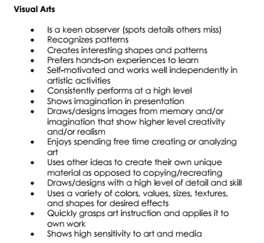
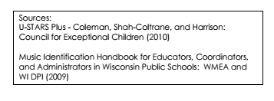

Slide 26
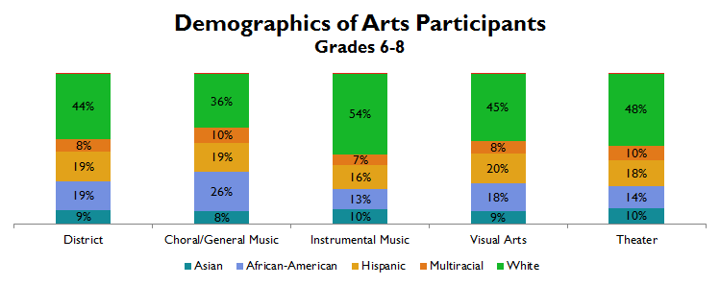
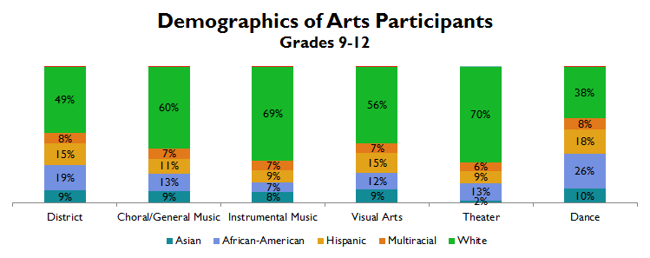
Arts Participation by Race/Ethnicity
African-American students are overrepresented in choral/general music and underrepresented in instrumental music
African-American and Hispanic students are underrepresented in instrumental music, overrepresented in dance;
white students are overrepresented in all arts aside from dance
Notes:
Again, because we are focusing on Access and participation, this slide displays a comparison of district demographics to demographics in Arts participation. The top set of bar graphs illustrates an overrepresentation of African American students in choral/general music and an underrepresentation in instrumental music. This is the reverse trend for white students. Hispanic student participation varies from 16% to 20% where the district percent enrolled is 19%.
The bottom set of graphs shows that African American and Hispanic students are underrepresented in instrumental music and overrepresented in dance. White students are overrepresented in all arts with the exception of dance. Hispanic students are underrepresented in all areas with the exception of Visual Arts and Dance.

Slide 27
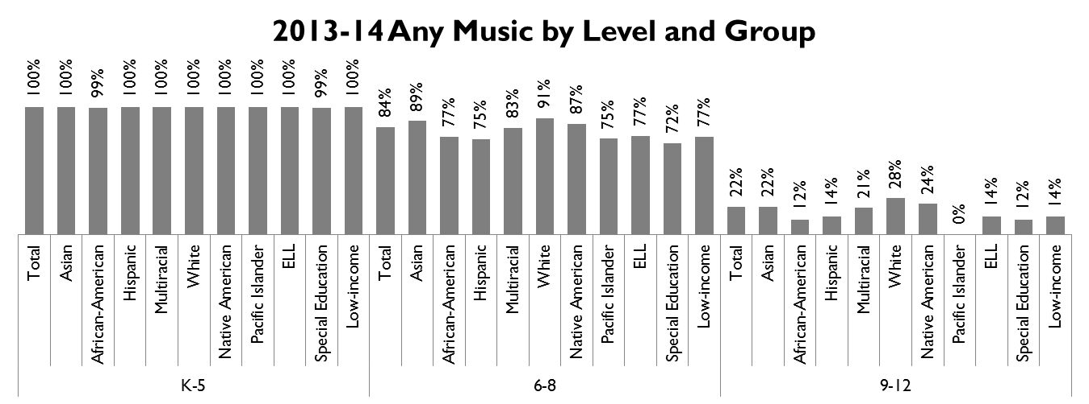
Any Music
Large drop-off in participation from Grades 6-9
Participation low in HS,
Gaps between racial/ethnic groups

Slide 28
What do YOU think?
IDENTIFICATION AND INTERVENTIONS

Slide 29
CONTACT INFO
Laurie Fellenz
Arts Education Coordinator
608-663-5227
lfellenz@madison.k12.wi.us

