Slide 1
DPI Javits Grant:
Expanding Excellence Initiative
State Leadership Cadre March 2016

Slide 2
Expanding Excellence Initiative
Purpose: Mitigate disproportionality in identification of and the Excellence Gap for students that qualify for free/reduced lunch and/or are English language learners

Slide 3
Structure of Project
District Leadership Cadre: (Milwaukee, Racine, Kenosha)
Demonstration Schools
State Leadership Cadre
Strategic Planning Team

Slide 4
Project Goals:
Collaboration
Assessment
Instruction
Use the components of the RtI Framework to increase the percentage of high ability/high potential students identified for advanced services and achieve at advanced levels

Slide 5
Wisconsin Department of
Public Instruction’s VISION for RtI:

Slide 6
Think Continuum of Supports
More than a year behind, gaps and misconceptions from many years | Gaps and misconceptions disrupt participation | Struggles with some assignments | Keeps up | Thrives | Excels | Years ahead

Slide 7
Principles of RtI
RtI is for ALL children and ALL educators
RtI must support and provide value to effective teaching practices.
Success for RtI lies within the classroom through collaboration
RtI is a framework that supports academic and behavioral success.
RtI supports and provides value to the use of multiple assessments to inform instructional practices
RtI is something you DO, not necessarily something you buy.
RtI emerges from and supports research- and evidence-based practices.

Slide 8
Key Characteristics of Effective Gifted Programs
Systemic | Integrated with schoolwide initiatives and programming across all grade levels, K-12. Opportunities should be incorporated into the regular school day and school year.
Collaborative | The responsibility of all staff members working in a collaborative fashion to meet student needs.
Sustainable | An integral part of the school district’s staffing and funding plans. It should not be dependent on any particular person or funding sources.
Responsive | Responsive to local student demographics, curriculum, resources, and needs.
Fluid | Flexible and continuously adapt to student need. Programming will likely differ based on local needs and community resources. Plans may vary from district to district and school to school.
Appropriate | Provide opportunities that are in place of, not in addition to, regular classroom instruction and activities
Comprehensive | Consider the “whole child” by encouraging academic, social, and personal growth of the students.
Aligned | Have goals that are clear and aligned with state statutes, administrative rule, professional standards, research, and effective practice.
Measurable | Have goals that are specific enough so that progress toward them can be readily evaluated on an ongoing basis

Slide 9
Connections...
What similarities and differences do you notice between the Key Characteristics and the Principles of RtI?

Slide 10
MLSS Roadmap

Slide 11
Mapping Instructional Practices
What pre-assessment and strategies to intensify instruction are used systematically at the Universal level? For talent development?
What is our menu of research-based supports for advanced learning beyond the reach of the Universal?
Who provides instruction at the Selected and Intensive levels? When? How often?
To what extent do our Selected and Intensive levels of support provide systematic and continuous instruction to extend student development with CCR / CCSS?

Slide 12
Mapping Collaborative Structures
●What teams meet at each level of support? Who sits at the table? How much time is scheduled for teams to collaborate around data and instruction for advanced learners at each level of support?(frequency, duration)
●What strategies are in place to support teams in analyzing data, making instructional decisions, and matching supports & needs? (roles and protocols)
●How are students/families/the community engaged in each level of support?

Slide 13
Mapping Screening and Assessment Practices
What multiple measures / data are part of your screening process?
What processes are in place to collect and document data, present data in user-friendly formats, and create student profiles?
How do you ensure processes are consistent across time, people, and places?
What strategies are in place to learn more about students (dig deeper) as needed?

Slide 14
Progress Monitoring for Advanced Learners
Are students meeting short- and
long-term goals?
2. Are students making progress at an acceptable rate?
3. Does the instruction need to be changed?
4. Are the right supports available for individuals? for your school?

Slide 15
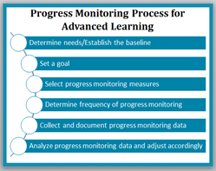

Slide 16
Looking at Inequity
In Wisconsin in 2014, our 66,702 teachers were…
95% White……..76% Female……..72% White Female
Haitian Proverb: A fish can’t see the water

Slide 17
Culturally Responsive Practices
CULTURALLY RESPONSIVE PRACTICES
include the degree to which a school’s programs, practices, procedures, and policies account for and adapt to the broad diversity of students' race, language, and culture.

Slide 18
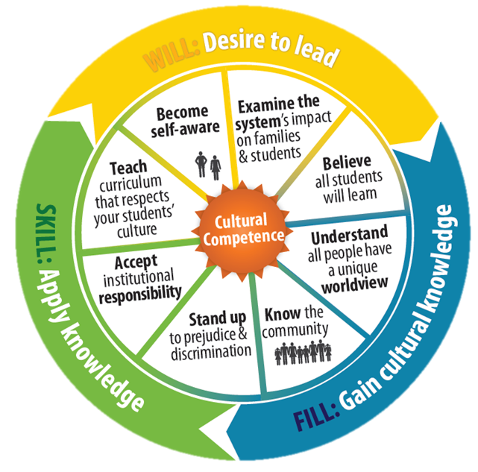
Cultural Competence
From “Believe all students CAN
learn”, to “all students MUST learn”

Slide 19
Next Steps...
Quantifying Achievement Gaps
Calculating RI
Developing Strategies to “turnkey” info
Cadre Meetings 3 times/year over 3 years
Demonstration Schools - developing plan and sharing results

