Slide 1
Joyful learning and living
Sharon Daly: School District of Cambridge

Slide 3
What Fills our Kids Hearts with Happiness?

Slide 4
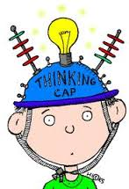
Can Learning be Joyful?
Should Learning be Joyful?

Slide 5
Is Joy ever part of our focus or conversation?
What does research in neuroscience tell us about the connection between joy and effective learning?

Slide 6
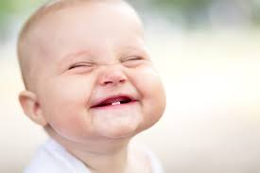
What about Joyful Parenting of gifted students?

Slide 7
JOY-O-METER
Where are you at?
Where are your kids at?
0 1 2 3 4
The importance of taking a Joy-0- Meter: We pay attention to what we think is important.
Joyless
Rarely Joyful
Somewhat Joyful
Mostly Joyful
Joyful, Joyful!

Slide 9
What Joy is NOT
Everything has to be fun
There is never any struggle or problems
Happy, Happy, Happy all the time
Taking the Easy Way

Slide 10
Joy: A Subject Schools Lack
Becoming educated should not require giving up pleasure.
Atlantic Monthly, January 26, 2015
Susan Engel (Developmental Psychologist)

Slide 11
"standards," "results," "skills," "self-control," "accountability," “response to intervention”, “college and career readiness”
The current landscape of education-How do these buzzwords correlate to research on how students learn best?
How can parents,educators, and students advocate successfully for joyful learning?

Slide 12
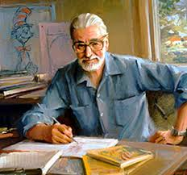
How can we prevent bad translations?
No No
NO DR. Seuss Days! NO school plays!
NO choice books! Canned curriculum! Rote
Learning! Get ready for college!

Slide 14
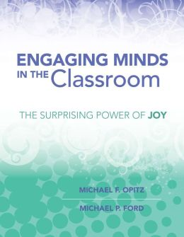
Engaging Minds and the Connection between Joy and Learning
Michael Ford: Professor at UW Oshkosh
Michael Ford is a professor of reading in the College of Education and Human Services at the University of Wisconsin Oshkosh. He has been involved with literacy education for more than 30 years as a first-grade and Title I teacher as well as a researcher and teacher-educator. His work with the international school associations has taken him to Africa, Europe, Central America, South America, and the Middle East.
http://www.heinemann.com/authors/1482.aspx
Michael Opitz
A former elementary school teacher and reading specialist, Michael Opitz is professor emeritus education of reading at the University of Northern Colorado where he taught undergraduate and graduate courses and supervised doctoral dissertations. He is now a literacy consultant and author well known to individual teachers, instructional leaders, and researchers as the author of numerous professional and curricular resources and through his extensive work in schools nationwide.
http://www.heinemann.com/authors/1268.aspx

Slide 15
Engaging Minds in the Classroom: The Surprising Power of Joy
“…acquiring knowledge or skills in ways that cause pleasure or happiness…what we are suggesting is that wrestling with new ideas and taking risk to learn new content requires persistence and the willingness to work through difficulties as they arise: through this experience, students experience joyful learning.Michael Opitz and Michael Ford

Slide 16
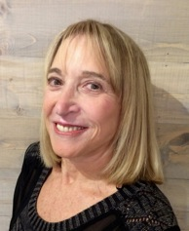
Judy Willis- Neurologist/Teacher: Radteach.com
RB
Board Certified Neurologist, Teacher (Middle School)
Professor Univ. of California, Santa Barbara

Slide 17
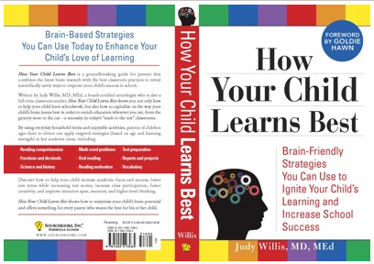
One of Judy Willis’ books

Slide 18
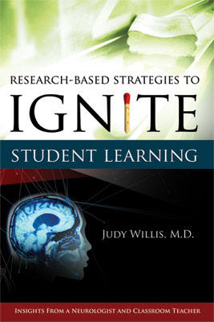

Slide 19
What to do When Your Child Hates School
The reason I left my neurology practice and became a teacher was because I had a profound increase in the children referred to my practice by teachers suspecting attention or other neurological disorders causing them to "act out" or "zone out" in class. When I observed the joyless force-feeding of facts by teachers who were given the impossible task of cramming test material into these young brains, my heart went out both the students and their teachers. I joined their ranks, and made correlations between the neuroscience research about stress, attention, behavior, and memory. I spent ten years in my classrooms implementing strategies to promote the neuroscience of joyful learning.
https://www.psychologytoday.com/blog/radical-teaching/201007/what-do-when-your-child-hates-school

Slide 20
Where Did the Joy of Learning Go? - Judy Willis
https://www.psychologytoday.com/blog/radical-teaching/201512/where-did-the-joy-learning-go
“For many children, the stress response to boredom and low personal relevance builds year after year when they do not find learning interesting or relevant. When children's brains develop negativity to school, the stress state limits their voluntary control to sustain attention in class, do homework carefully, and persevere at challenging classwork.
Their brains learn to automatically resist putting mental effort into activities they have experienced as boring or irrelevant.

Slide 21
This is often the situation when children who are quite intelligent have difficulty with rote memorization. Since memorization is often what is tested it is inaccurately perceived by children as a measure of their intelligence. They develop the belief that their failure to get high grades on rote memory tests means they don't have the ability to succeed. That mindset is not only inaccurate, but when taken on by your child, means their brains go into the fixed mindset of avoiding challenges and loss of motivation to persevere through setbacks.”

Slide 22
Research in Neuroscience Supports
Effective Information Processing
Long Term Memory Storage
Joyful Learning
Positive Impact on Student Learning and Retention

Slide 23
The Neuroscience of Joyful Education
“When students are engaged and motivated and feel minimal stress, information flows freely through the affective filter in the amygdala and they achieve higher levels of cognition, make connections, and experience “aha” moments.”
Judy Willis: The Neuroscience of Joyful Education, Educational Leadership

Slide 24
cont...
“Unfortunately, the current emphasis on standardized testing and rote learning encroaches upon many student’s joy. In their zeal to raise test scores, too many policymakers wrongly assume that students who are laughing, interacting in groups, and being creative…are not doing real academic work.”
Judy Willis: The Neuroscience of Joyful Education, Educational Leadership

Slide 25
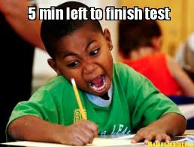

Slide 26
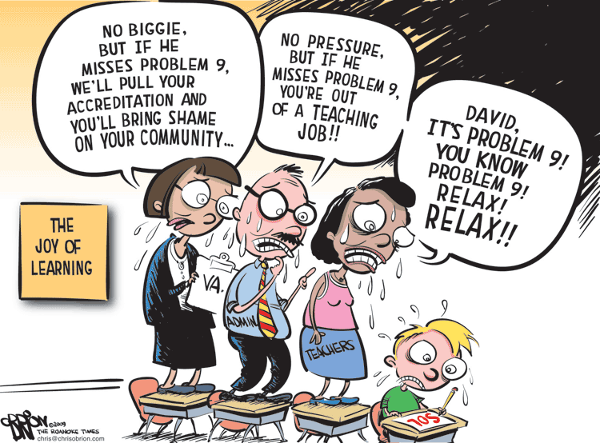

Slide 27
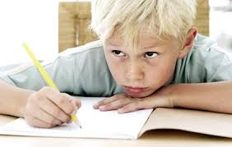
Test Anxiety,high stakes performance,over emphasis on scores as measure of worth

Slide 28
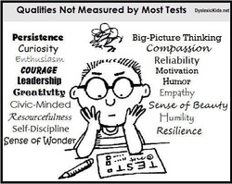

Slide 29
The Test is Life

Slide 30
“Joy and enthusiasm are absolutely essential for learning to happen—literally, scientifically, as a matter of fact and research. “The neuroscientific research about learning has revealed…the qualitative improvement in brain circuitry involved in memory and executive function that accompanies positive motivation and engagement.”
The Power of Joyful Learning, Judy Willis. School Leadership 2.0

Slide 31
What Increases Motivation?
Opitz and Ford
Self-Efficacy and Competence: beliefs the learner has about the ability to be successful
Control over factors that contribute to success or failure
Growth mindset vs fixed
Importance/Usefulness/Time and Effort required

Slide 32
Motivation continued
Interest and Intrinsic Value
Goals Mastery-demonstration of ability
Vs a grade, “good job,” “you’re so smart”

Slide 33
Factors Related to Engagement
Attention
Commitment
Persistence
Value
Opitz and Ford

Slide 34
Joseph Renzulli-University of Connecticut
Enjoyment, Engagement, and Enthusiasm
Allow students to choose what interests them within the existing units of study
Give students the opportunity to do what professionals do
Allow the outcomes/product to be the decision of the student
Parents and Students: Advocate

Slide 35
<iframe width="560" height="315" src="https://www.youtube.com/embed/dFHNr_T6TSY?rel=0" frameborder="0" allowfullscreen></iframe>

Slide 36
Leveraging What We Know About How Students Learn
Coordination of …
So that we create and foster…
Curriculum Design
Instruction
Resources
Authentic Assessment
Practices
Student Engagement
Inquiry
Motivation
Student Choices
Context and Connection
Improved student outcomes
Joy Enhancers!

Slide 37
Gifted and Talented Students
Unique characteristics
Stresses and
pressures.

Slide 38
What Pressures do students face?
The need to be good in everything
Boredom/lack of engagement
Goal mastery doesn’t always equal learning
Pressure to conform
Overemphasis on grades/scores
Feeling like an impostor
College acceptance
Lots of interests/activities- lack of down time

Slide 39
Pressures ...
To perform
To conform
To meet other’s expectations
To realize potential- multipotentiality is difficult!
Perfectionism

Slide 40
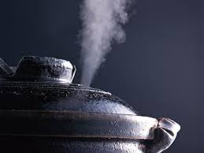
Pressures can build up during the school day
And children bring them home

Slide 41
Joy Depleters
Remember the Little Prince Trailer?
Always projecting ahead-not focusing on the now. Missing the moments that make up a meaningful life
External expectations- not honoring the student’s voice
Article: Expectation Overload: Helping Multpotentialed Students Find Happiness
Author: Sarah Marie Catalana, Doctoral Student, University of Georgia, Teaching for High Potential Fall 2015

Slide 42
Excerpt from “Expectation Overload” article
From the student’s point of view, multiple talents may signify overwhelming decisions and looming pressure to perform perfectly in everything they do. When my teachers told me I could be anything, I interpreted this encouraging comment as a command:”You have to do everything and do it perfectly.”

Slide 44
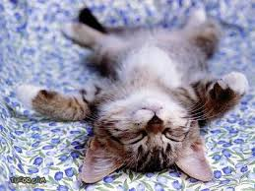

Slide 45
When joy is lacking...
Learning is Negatively Impacted
Leading to
Added stress
Anxiety
Low motivation
Lack of engagement
Lack of relevance
Lack of autonomy and control

Slide 47
HOW CAN WE HELP BUILD KIDS CAPACITY FOR JOY?
INTENTIONAL FOCUS UNSTRUCTURED TIME
BALANCE PLAY
GRATITUDE SILLINESS
FLOW ACCESS TO NATURE
CHOICES AUTONOMY
REFRAMING MISTAKES BUILDING SELF-ADVOCACY
PURSUING PASSIONS AND INTERESTS
CHECK THE JOY-O-METER FREQUENTLY

Slide 48
Building Capacity for Joy
Positive affirmations Working for a cause
Limiting use of devices- unplug Volunteering
Access to mentors Starting a Group
Talking/visiting with people who love their work
People/kids who are making a difference
Limit access to news
Purposeful Optimism Connecting globally
Doing What Professionals Do

Slide 49
Building Capacity for Joy
Authentic Voice and Audience- Student self-publishing, blogs, causes, volunteering, making videos, podcasts, etc.
Creativity Humor
Designing/imagining Wonder
Novelty Whimsy
Appropriate Challenge
Persevering to accomplish a personal goal

Slide 50
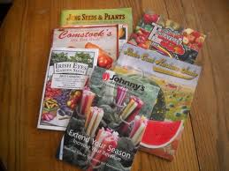
What can Parents do to help classroom teachers, schools have an intentional focus on joy? Best practices for learning?
Idea Generator- Planting seeds!
Share the research
Start the conversation
Connecting brain research about how
students learn best is powerful advocacy!
Book studies
Professional Development

Slide 51
Appropriate Challenge-Meeting the Needs of the Learner
Zone of Proximal Development=Appropriate Challenge
This is a great talking point for parents/students to use for advocacy

Slide 52
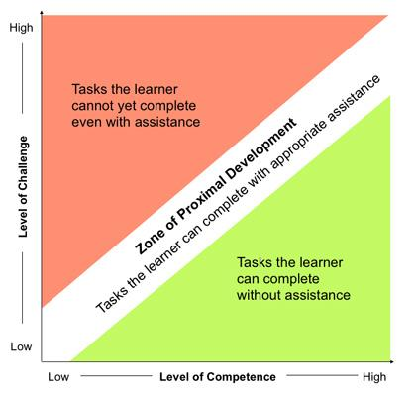

Slide 53
Appropriate Challenge- The Zone of Proximal Development
Think of Goldilocks and the Three Bears
Too Easy
Too Hard
Just Right!

Slide 54
The Power of Gratitude As a Joy Enhancer
What are you grateful for?
How can we foster feelings of gratitude?
Gratitude journals/conversations/affirmations
Intentional focus on gratitude in conversations with your child

Slide 55
Framing mistakes in a positive way
Mistakes are stepping stones to learning
Mistakes provide new opportunities for change and growth
Failure is how the best innovators achieve success- by testing, creating, imagining, until they reach their desired goal
Focusing on mistakes limits our abilities

Slide 56
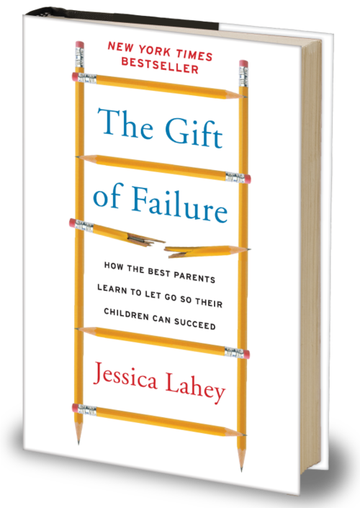

Slide 57
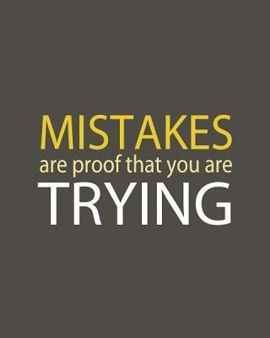

Slide 59
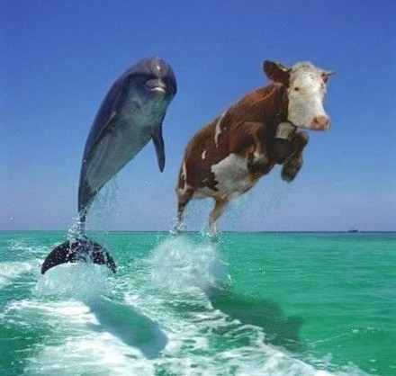
What do our students need?
Humor helps!

Slide 60
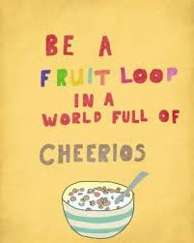

Slide 61
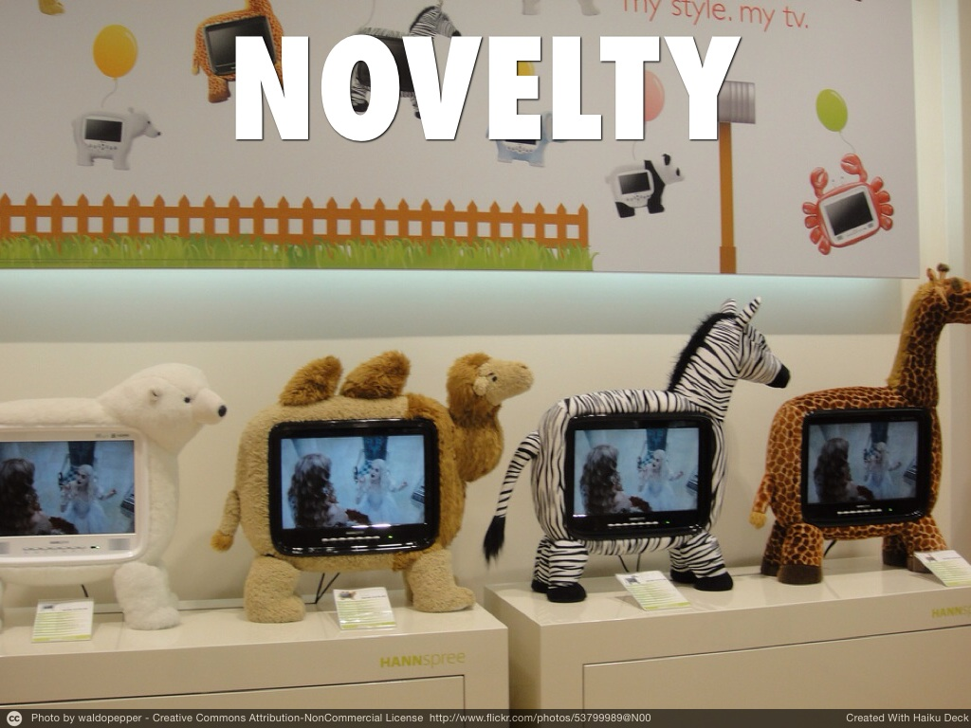

Slide 63
Challenge and Engagement

Slide 64
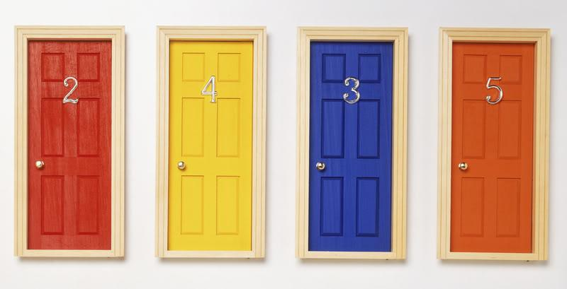
Our students need authentic choices

Slide 65
Flow: doing something for the sheer joy and engagement- pursuing passion-
When have you been engaged in something challenging but it didn’t feel like work?

Slide 66
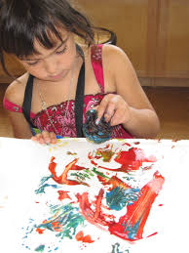
Creativity-free play- unstructured activities

Slide 67
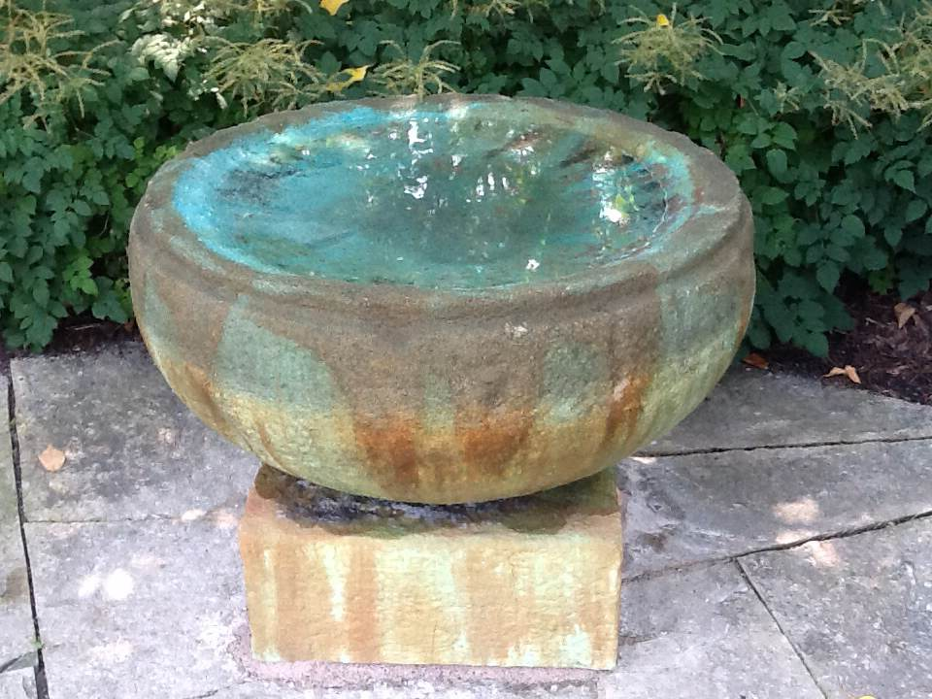
Time to reflect, to be filled up rather than depleted

Slide 68
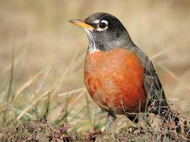
A Sense of Wonder!
Student Centered Inquiry
Look up- Look at- Notice!
Present moment consciousness
wonderopolis

Slide 69
Poet- Mary Oliver
“Instructions for living a life.
Pay attention.
Be astonished.
Tell about it.”
― Mary Oliver

Slide 70
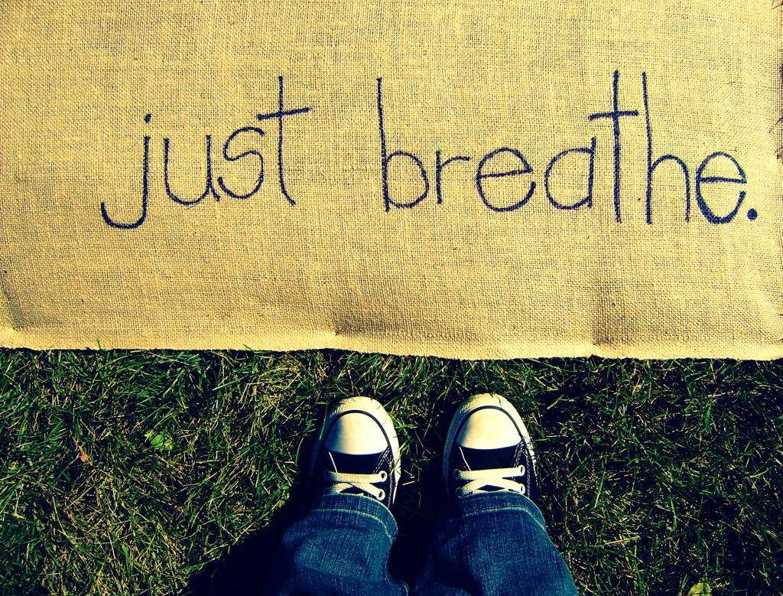

Slide 71
Other sessions tonight
Connect to Joyful Learning and Living including...

Slide 72
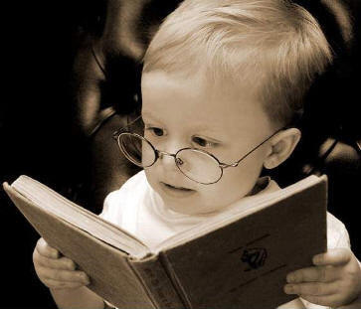
Our Students and self-advocacy
Deb Douglas Workshop

Slide 73
The ability to self-regulate
Parent Workshop- Mary Kennedy, Kathty Enstad, Amy Miller

Slide 74
Mindfulness
Being in the now, not the past or the future. Awareness
of the state of body/mind. Attention to what is going on in
the moment.
Scholastic: Mind Up! Curriculum
http://teacher.scholastic.com/products/mindup/
http://www.thehawnfoundation.org/
Lauren Knutson Workshop

Slide 75
Fixed Mindset
In a fixed mindset, people believe their basic qualities, like their intelligence or talent, are simply fixed traits. They spend their time documenting their intelligence or talent instead of developing them. They also believe that talent alone creates success—without effort. They’re wrong.

Slide 76
Growth Mindset
In a growth mindset, people believe that their most basic abilities can be developed through dedication and hard work—brains and talent are just the starting point. This view creates a love of learning and a resilience that is
essential for great accomplishment.
http://mindsetonline.com/whatisit/about/

Slide 77
Wrapping Up

Slide 78
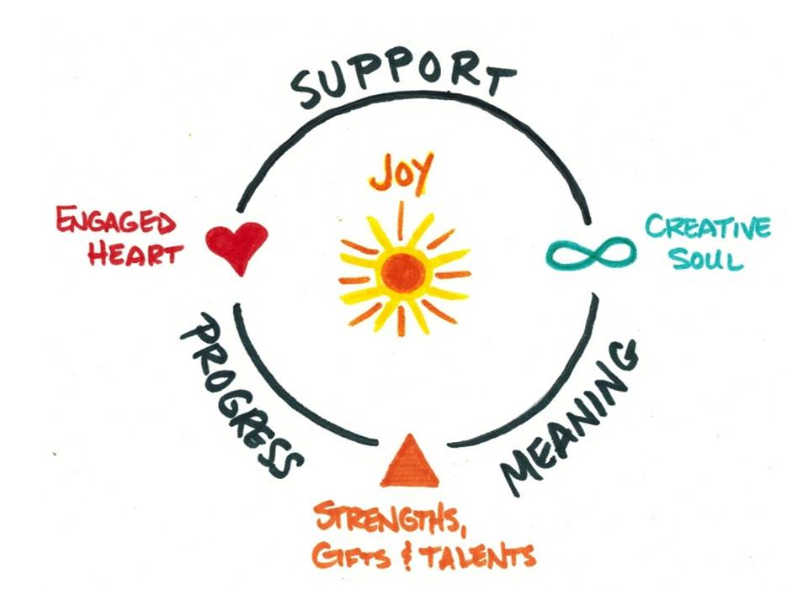
Joyful Learning and Living Positively Impacts Student Outcomes and Well-Being: Neuroscience Research supports this!
integralleadershipreview.com

Slide 80
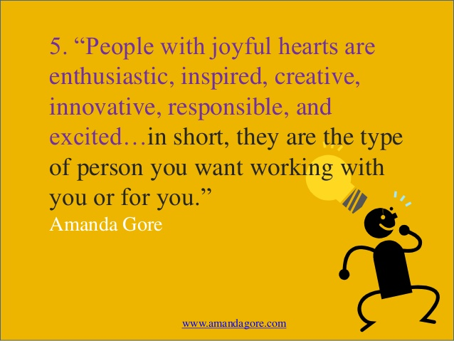
Amanda Gore is CEO of the Joy Project

Slide 81
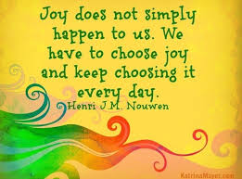

Slide 82
Thanks for attending Parent University
Take joy!
It’s good for your
Brain!
Sharon R.Daly, Cambridge School District

