Slide 1
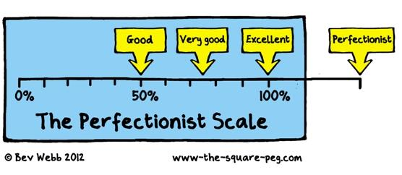
Perfectionism: From Surviving to Thriving
Greater Dane County Advanced Learner Network
Parent University
April 4, 2016

Slide 2
What professions would you like to see people that are closer to perfect in their work than not?
Notes:
We want people that work with and for us to do quality work.

Slide 3
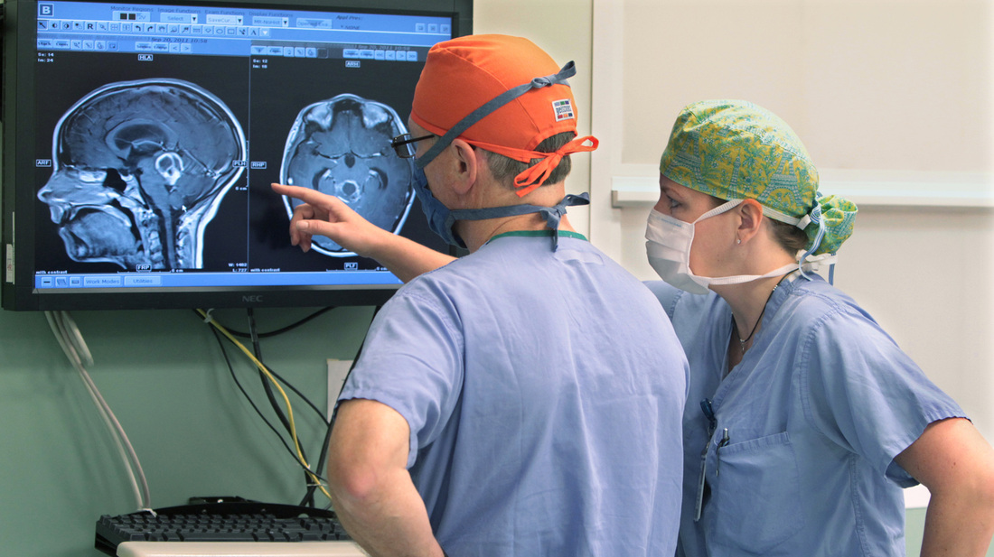
What adult professionals would you want to be closer to perfection than not?

Slide 5
Notes:
We are all on a continuum. You are here because of a concern = the goal is to support all gifted kids to move toward an Optimalist viewpoint and have strategies to support the move. Schools and parents working together can help many kids to gain strategies to move toward Optimalist. For others, outside counseling and supports can make a difference in supporting positive change.

Slide 6
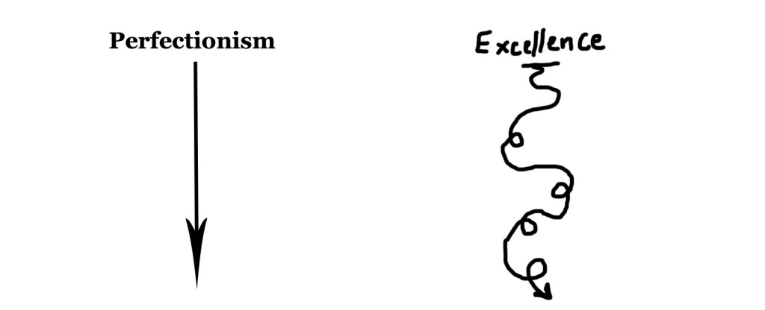

Slide 7
Notes:
There are some common characteristics among the gifted population. Perfectionism is one of them.

Slide 8
Perfectionism - What do “we” know?
If a child or adult has perfectionistic tendencies, will you see it in all areas of their lives?
Can perfectionism be healthy? Definitely!
Doing your best with the time you have and then moving on.
Setting high standards and embracing mistakes along the way.
Keeping your world organized and in order.
Understanding effort is required to learn and grow.

Slide 9
Unhealthy Perfectionism - When we see...
A state of anxiety about making errors or mistakes.
Having extremely high standards that may be unrealistic or require more time and effort than available.
Perception that others have extremely high expectations of them.
Difficulty hearing feedback - focuses on feedback as criticism.
Questioning own judgments.
Lack of coping strategies when “stuck” or overwhelmed.
A constant need for approval- focus is NOT on learning.
Perceiving one’s work is never good enough.
Feeling guilty if not engaged in meaningful work at all times.
Having a compulsive drive to achieve, where personal. value is based on what is produced or accomplished.
Not being able to start or quitting as soon as the work becomes difficult
Notes:
Unable to get started because of the fear of not doing something perfectly or well enough.
Quitting as soon as the going gets tough

Slide 10
When should you seek additional supports?
When Perfectionism Interferes with:
school work
extra - curricular activities
A Healthy Social Life
or your child exhibits symptoms of:
sleeplessness
avoidance of activities
eating disorders
continuous headaches and stomach aches

Slide 11
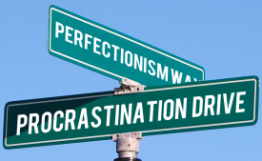

Slide 12
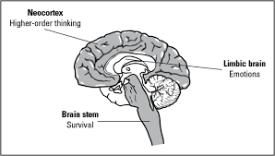
Why can Perfectionism interfere with learning?
Notes:
Rational Brain - where learning happens; Limbic System - emotions tied to learning; Primitive Brain/Brain Stem - survival Flight or Flight (Adrenaline Released) Limbic System - learning releases Dopamine (reward releases when you learn- I want to learn more) Seratonin - mood setting chemical - want kids comfortable or it interferes with learning

Slide 13
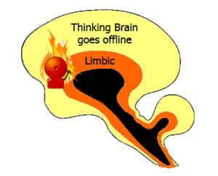

Slide 14
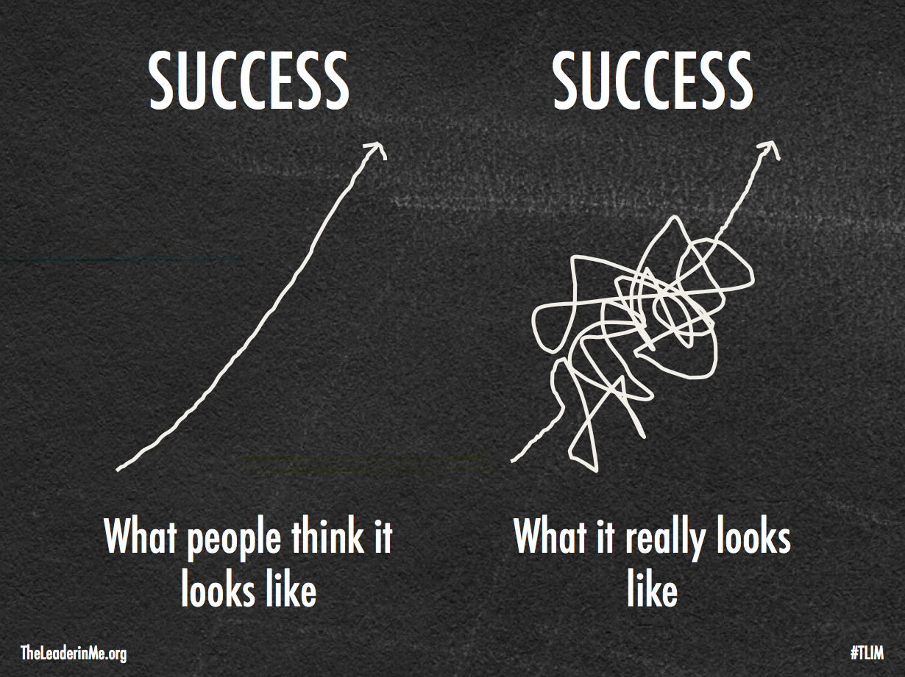
So, what do we do to support positive change away from Unhealthy Perfectionism?

Slide 15
The way to achieve big dreams is to fail along the way.

Slide 16
Tips to support moving up the Continuum
Watch for signs of unhealthy perfectionism and intervene if necessary.
Model a healthy approach to dealing with challenges and be aware of your own predispositions toward compulsive excellence.
Refrain from setting high non-negotiable standards.
Emphasize effort and process, NOT the end results.
Do not withhold affection, support or encouragement if goals are not met.
Read about successful people who made mistakes and experienced failures.
Model laughing at some of your own mistakes, expressing your frustration and moving forward.

Slide 17
Notes:
Kids need their sleep!

Slide 18
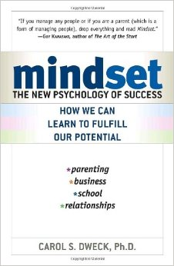
Having a Growth Mindset Matters!
Notes:
2006 - the beginning of the new research in brain development throughout a person’s lifetime

Slide 19
Support a Change in Thinking

Slide 20
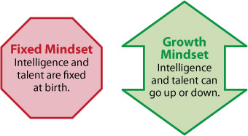
Notes:
Simple definition of fixed vs growth.

Slide 21
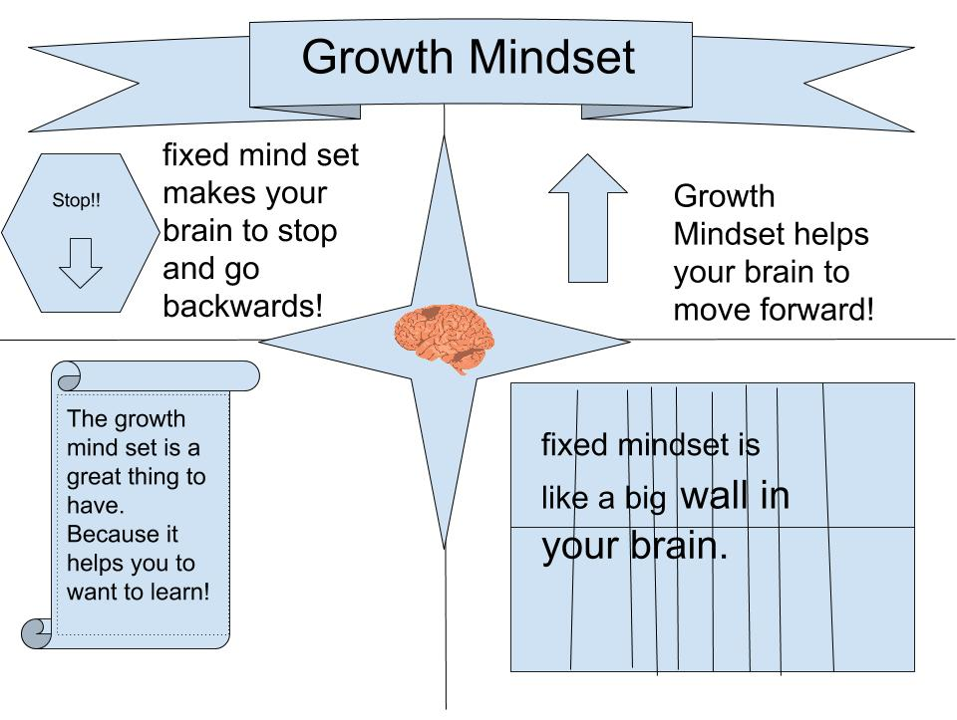

Slide 22
Mindset
Related to your belief about your ability
Creates a mental world for you to live in
Fixed Mindset - Ability cannot change
About 40% of population
Growth Mindset- Ability can change
About 40% of the population
Notes:
Special Ed students can have a fixed OR Growth Mindset; ELL; Typically Developing; Atypically Developing; Advanced Learner; Adults of all backgrounds;

Slide 23
How Attitudes Toward Mistakes Can Derail Our Learning - Trevor Ragan (:55-2:35)
Notes:
not compliant students - successful learners

Slide 24
Using a Common Language can promote Growth Mindset all day, every day.
Teach about the Brain and learning
Teach Goal Setting
Teach what it means and feels like to put forth Effort
Teach kids to seek Alternate Strategies and Input from others when stuck
Use Growth Mindset Praise

Slide 25
How do We Promote a Growth Mindset?
Carol Dweck recommends that we need to teach about the brain and how the brain learns. (ALL AGES)
Neuroplasticity
Notes:
How do can we incorporate teaching about the brain and learning in an integrated way(s)
What will this learning do for kids and teachers?

Slide 27
From a Middle School English Student Reflecting on an article about “Grit”
That is how I used to feel about writing. In my mind I couldn’t see the shoreline when it came to writing; the objective was blocked by the fog, and it was impossible for me to see where I was going. The hardest part for me was thinking about what to write; there always seemed to be nothing to write about. But late last year and around the middle of this year, the fog began to clear and I could see the shore. One of the ways I accomplished this is by having a growth mindset. Late last year I began to think in a way that never really limited me to be stuck and unable to grow. Through me having a growth mindset, I could see through the fog so I was able to see and accomplish my goal. For me the biggest factor of grit is having a growth mindset. Like the author said, “With a growth mindset, anything is achievable.”

Slide 28
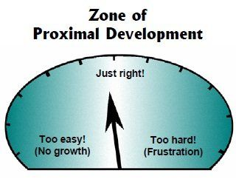
Notes:
review ZPD

Slide 29
Notes:
Does every learner need the same goals? Does every learner need to grow?
If the goldfish wants to jump from the small bowl to the large bowl, what does he need to do to get there?

Slide 30
Teach What Effort Feels Like
People were asked about intelligence and how much they thought it was down to effort and how much they thought it was about ability
Intelligence=______% effort _______% ability
Fixed = 35% effort vs. 65% ability
Growth = 65% effort vs. 35% ability

Slide 31
Never Say Can’t - Jennifer Bricker

Slide 32
But, a growth mindset is NOT just about effort. Effort is a means to an end, but the goal is learning and improvement.
Each student needs a
‘repertoire of approaches’
to learn and improve.
alternate strategies
seek input from others
Notes:
So, effort is not the only thing. It is a means to an end. Carol Dweck followed up her book with a recent article in Education Week about the over-emphasis on effort.

Slide 33
When students are stuck, we can appreciate their effort, but help them to continue to learn and grow by offering teaching or alternate strategies.
“Let’s see what you have tried and talk about what you can try next.”
Notes:
This is where good teaching comes in. We need to teach strategies, as well as how to ask for help at appropriate and strategic times.

Slide 34
Feedback - What is the Message?
Are you offering judgments about permanent traits or messages about a student’s ability to grow and to change?
Notes:
We need to think about what we are saying or implying to kids when we offer feedback and praise.

Slide 35
Set of 6 studies of children
Praised for
Ability/Intelligence
Praised for
Effort
Goals
66% of the group created
performance goals
90% of the group created learning goals
Enjoyment
decreased
continued
Persistence
decreased
continued
Performance
declined
improved
Lied about scores
40%
one individual

Slide 36
What should we praise?
Effort
Struggle
Learning
Improvement
Selection of Difficult Tasks
Persistence in the Face of Setbacks
Application of Strategies
Mary Cay Ricci 2015

Slide 37
Praise for a Growth Mindset
some examples
“I can see that you really understand how to do ________.”
“That homework was long and involved. I admire the way you concentrated and finished it.”
“How did you figure that out?”
“You have really been putting in a lot of practice and your improvement shows it.”
Notes:
some of this is not really praise, but engaging in a conversation about the process of the learning and effort. That kind of attention can be reinforcing - it does not have to be praise specifically. Praise is necessary early on in developing a Growth Mindset. Discussion and empowerment is more important as Growth Mindset is developed.

Slide 38
Shifting Feedback: The Power of YET
You can’t tie your shoes…YET, but you can do the first part.
You can’t solve an equation looking for an unknown side of a right triangle…YET, but remember how hard you worked to master quadratic equations?
You haven’t developed possible solutions…YET, but you DO know two things that don’t work.
You’re right, you can’t play that piece flawlessly…YET, but you have mastered other difficult pieces.
Adapted from Mary Cay Ricci 2015
Notes:
When kids are frustrated about what they CAN’T do, validate their frustration, include YET, and point out what they HAVE mastered so far.
Amy and video games. lose 50% of the time. consequence is minimal and VERY brief

Slide 39
“How many ways did you try it before it turned out the way you wanted?”
“That looks like it took a lot of work.”
“Are you pleased with what you did?”
“What did you learn from this assignment?”
“What did you learn that surprised you?”
Notes:
other ideas?

Slide 40
Good Feedback is Important
Constructive criticism is necessary if we want people to develop and learn.
Praise is not a villain – praising for the effort and the process will help the student to become more motivated and ultimately more resilient.

Slide 41
Reacting to Mistakes
Are mistakes problematic?
harmful?
to be ridiculed?
Or, are they helpful?
Notes:
Ask for additional ideas

Slide 42
Reacting to Mistakes
When your child makes a mistake, does your feedback help them
to understand how to fix their mistake or does it label or excuse them?
Does the feedback discourage
or build resilience?
Notes:
Ask for additional ideas

Slide 43
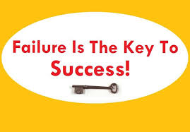

Slide 44
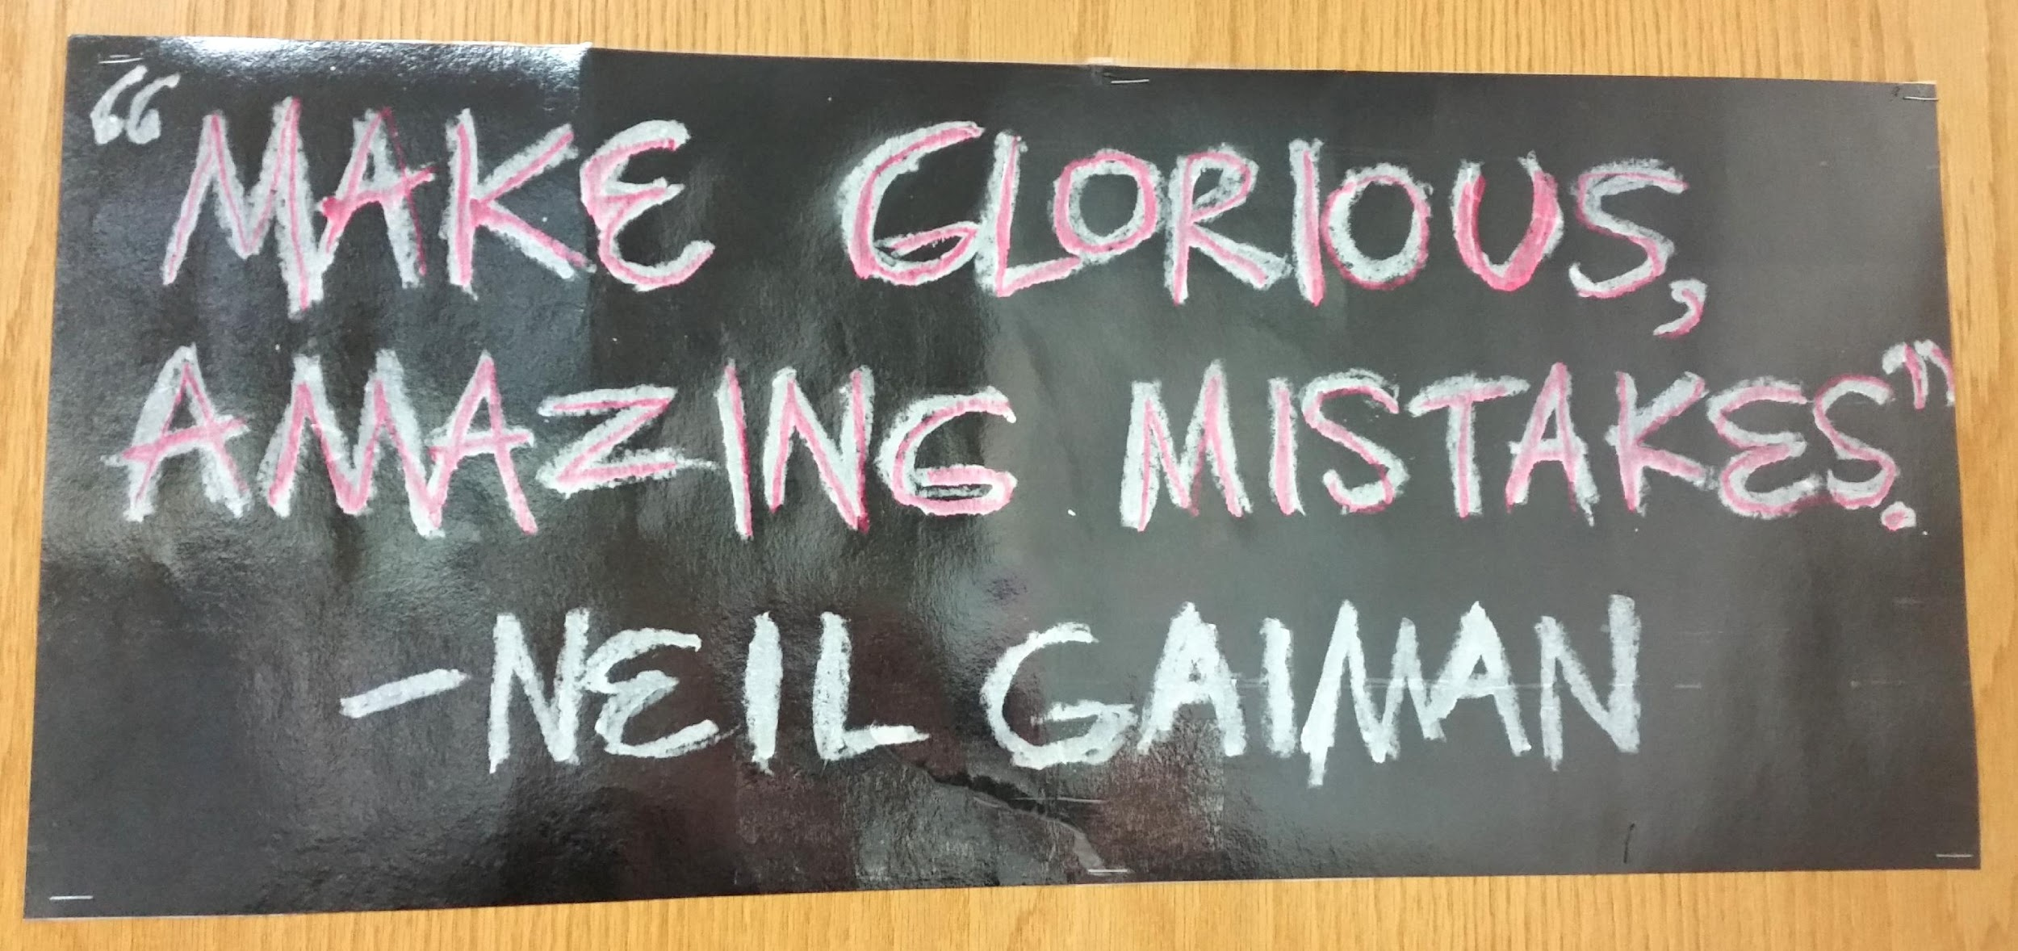

Slide 45
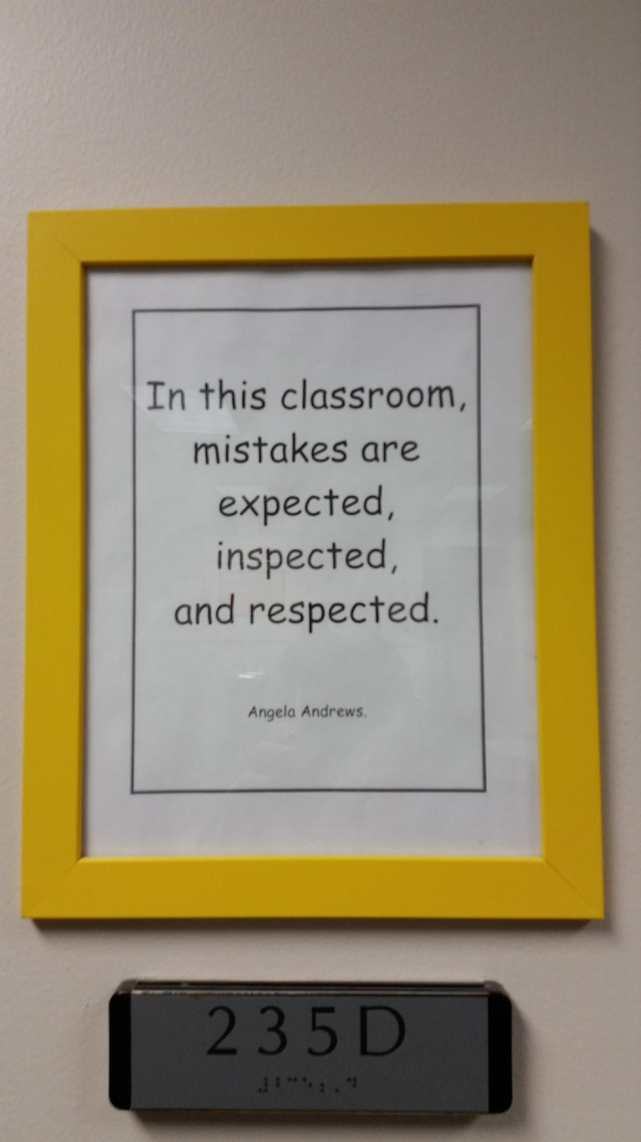
Notes:
especially INSPECTED! In order to learn from our mistakes.

Slide 46
Model a Growth Mindset
Acknowledge that we’re all a mixture of fixed and growth mindsets.
This is a journey, not a proclamation.
Notes:
There seems to be developing a fixed mindset about growth mindset! We all want to say that we have a growth mindset across all areas of our lives, but most of us don’t. We need to embrace that we are all on not just one continuum, but several continua in various aspects of our lives.
We need to model this journey rather than proclaim ourselves to be of a growth mindset.

Slide 47
When YOU face a challenge, how do you respond?
Do you feel incompetent or defeated?
Do you look for an excuse?
Do you look for an easier way?
Or, do you set goals, seek input, try a different strategy?
Observe your own reactions to setbacks or criticism and make sure that you are modeling what you expect to see in your children.
Notes:
What do you do when you are frustrated with the behavior of your students? With how your students are learning? Can this be an opportunity to model a growth mindset to them?

Slide 48
Promoting a Growth Mindset
Teach about the brain and it’s HUGE potential for learning.
Teach how to set goals so your children can see their learning occur.
Provide opportunities to find out what effort feels like.
Provide a ‘repertoire of approaches’.
Praise for strategies, effort, and processes rather than for intelligence or ability.
React to mistakes in such a way that resiliency and learning are promoted.
Model a growth mindset (and share others’ experiences).

Slide 50
Let’s help prepare our children to embrace change and to thrive in new learning opportunities of the future!

Slide 51
Thank you for your
active participation today!
Amy Miller
Advanced Learning Coordinator
Oregon School District
alm@oregonsd.net

Slide 52
